Slide 1
Mojaloop Evolution Workstream
End of PI-27 Report

Slide 2
Workstream Update
Workstream Name: | Mojaloop Evolution
Roadmap Pillar: | Foundation: Quality Product
Lead: | James Bush
Workstream Objectives: | Plan ahead for the continuous improvement of the Mojaloop codebase
Progress Against Objectives: | Tigerbeetle ledger integration in progress Chart of Accounts improvements in progress Authentication and authorization architecture reviewed with DA Audit trail architecture reviewed with DA
Anticipated Progress by PI End: | As above.
Roadblocks: | None
Support Needed: | Engineers with Mojaloop core services experience Product level input on NFRs from adopters, SIs and wider community

Slide 3
Progress Since Last Report
Tigerbeetle ledger integration in progress
Grateful thanks to Tigerbeetle Inc. for donating Lewis Daly’s time to perform this work for the community
Accounting Ledger improvements in progress
Redesign of our Chart of Accounts to better reflect global accounting best-practices
Authentication and Authorization architecture review with DA
Discussion of pros/cons of moving to service layer AuthN/AuthZ vs current service mesh. DA decision to not change at this time
Audit Trail requirements and architecture review with DA
Consultation ongoing with regulator experts to support revamp of requirements

Slide 4
Objectives for PI-28
Complete Tigerbeetle integration implementing new Chart of Accounts structure
Finalize audit trail regulatory consultation, publish requirements and agree any necessary architectural changes with DA.

Slide 5
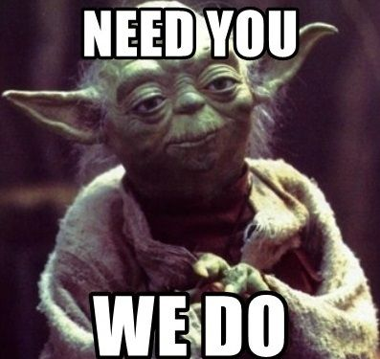
Joining the workstream
Mojaloop Slack: #ws-mojaloop-evolution
Weekly meeting (zoom) on Tuesdays @ 0900 UTC

